Slide 1
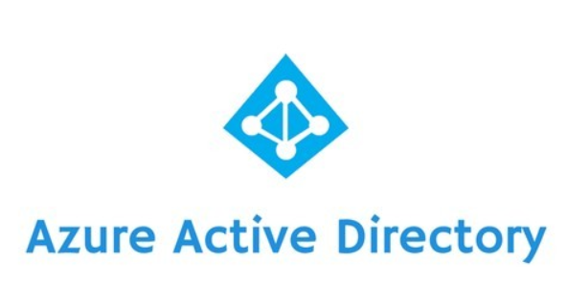
Module 4 Azure Active Directory
Section 4 - Azure AD Federated with AD FS
June 2018

Slide 2
Agenda : Module 4 – Section 4 : Azure AD federated with AD FS
01
06
Azure AD tenant federated with AD FS Overview how to federate Azure AD with AD FS.
Federation concepts Introduction to the Federation concepts and the related terminology
02
Active Directory Federation Services (AD FS) overview Description of Active Directory Federation Services main purposes (such the Security Token Services function).
07
Azure AD authentication flow when federated with AD FS Review of some Azure AD federated authentication flows
03
AD FS Roles, Topologies and main requirements Review of the different AD FS components, configuration topologies and requirements.
08
Friendly AD FS features for AAD A quick list about some Azure AD oriented AD FS features. Including an overview about the new Extranet SMART Lockout.
04
AD FS federation trusts Introduction to claims provider trust and relying party trust. Quick overview about the related claims rules transformation engine allowing to control which Claim is issued or accepted by AD FS.
09
AD FS links AD FS links to know
05
How Federated Authentication works Review of some federated authentication flows

Slide 3
Federated Identity
Federated identity, or the "federation" of identity, describes the technologies, standards and use-cases which serve to enable the portability of identity information across otherwise autonomous security domains. The ultimate goal of identity federation is to enable users of one domain to securely access data or systems of another domain seamlessly, and without the need for completely redundant user administration. Identity federation comes in many flavors, including "user-controlled" or "user-centric" scenarios, as well as enterprise controlled or B2B scenarios. ^{*)}
^{*)} Source: Wikipedia – http://www.wikipedia.org

Slide 4
Federation Concepts
Federation is a process that enables distributed authentication, and authorization across organizational and platform boundaries.
Federation is based on a trust relationship that is protected by a trust key or password.
AD FS uses X.509 digital certificates to establish federation trust
Federation provides single sign-on (SSO) feature to web applications and web services across security boundaries:
Users need to remember only a single user name and password.
Federation relieves the burden of extranet provisioning:
Management of user accounts is minimized.
Notes:
AD FS Federation:
AD FS is a process that enables distributed identification, authentication, and authorization across organizational and platform boundaries.
It allows you to project one user’s identity (belonging to an account organization) to another organization (resource organization). In such scenarios, web applications trust other organizations (accounts) for the authentication stage, but the authorization stage is still kept under their own control (by allowing or refusing the access to them).
Federated authentication provides a standards-based solution to the issue of trusting identities across diverse domains, and it can also support single sign-on (SSO). Federated authentication is therefore becoming more common across all types of applications, especially cloud-hosted applications, because it supports SSO without requiring a direct network connection to identity providers. The user does not have to enter the credentials for every application. This increases security because it prevents the proliferation of credentials required to access many different applications, and it also hides the user’s credentials from everything else, except the original identity provider. Applications will therefore see only the authenticated identity information contained within the token.
Why Federation?
It can easily establish a common policy for sharing resources:
A Standard Operating Procedure (SOP) can apply to multiple partners.
Complexity of liability concerns can be minimized.
Improved user experience during collaboration:
SSO
Single username/password to remember
User account administration benefits:
No need to create multiple (shadow) accounts
Low volume to helpdesk for account management
Benefits for service providers:
There’s no need to store user accounts or user attributes for customers
They only need to manage their services and the Federation trust with partners
Benefits for account providers:
Considerable cost savings because there is no need to self-host services
Considerable cost savings related to user training. Users can continue to utilize the on-premises Active Directory credentials.

Slide 5
Federation Concepts: Components Involved
Identity Provider
Service Provider
Different parties participate in Federation in different ways. The main three roles are:
Identity Providers, which issue digital identities.
Relying Parties (aka : Service Provider), which require identities.
Identities, which are the individuals and other entities about whom claims are made.
Note: In many cases, the participants in a Federation play more than one role.
service trust IdP
2. Idp returns tokens
1. Consumer requests token
3. Consumer presents token to service
Identity (service consumer)
Start
4
Notes:
Federation identity allows you to separate user authentication from the application code, and delegate authentication to a trusted identity provider. This can considerably simplify development and allow users to authenticate using a wider range of identity providers (IDPs) while minimizing the administrative overhead. It also allows you to clearly decouple authentication from authorization.
The trusted identity providers may include corporate directories, on-premises federation services, other security token services (STSs) provided by business partners, or social identity providers that can authenticate users who have, for example, a Microsoft, Google, Yahoo!, or Facebook account.
The graphic in the slide area illustrates the principles of the federated identity pattern when a client application needs to access a service that requires authentication. The authentication is performed by an identity provider (IDP), which works in concert with a STS.
The IDP issues security tokens that assert information about the authenticated user. This information, referred to as claims, includes the user’s identity, and may also include other information such as role membership and more granular access rights.
This model is often referred to as claims-based access control. Applications and services authorize access to the features and functionality based on the claims contained in the token.
The service that requires authentication must trust the IDP. The client application contacts the IDP that performs the authentication. If the authentication is successful, the IDP returns a token containing the claims that identify the user to the STS (note that the IDP and STS may be the same service).
The STS can transform and augment the claims in the token based on the pre-defined rules, before returning it to the client. The client application can then pass this token to the service as a proof of its identity.
Note: In some scenarios, there may be additional STSs in the chain of trust. For example, in the Microsoft Azure scenario, an on-premises STS trusts another STS that is responsible for accessing an identity provider to authenticate the user. This approach is common in enterprise scenarios where there is an on-premises STS and directory.
Federated identity has another major advantage because, the management of the identity and credentials is the responsibility of the identity provider. The application or service does not need to provide identity management features. In addition, in corporate scenarios, the corporate directory does not need to know about the user (as long as it trusts the identity provider), which removes all the administrative overhead of managing the user identity within the directory.

Slide 6
Federation Concepts: Trust
Identity Provider must trust the Relying Party to:
Treat claims appropriately (respect confidentiality)
Verify the token
Keep itself secure
TRUST
Relying Party must trust the Identity Provider to:
Verify the identity of the users
Manage the claim data appropriately
Issue appropriate credentials
Keep itself secure
Trust relationship hinges on cryptographic secrets:
STS provides a certificate with a public key to the relying party
A token is digitally signed by the identity provider that is using the private key
Relying party verifies the token signature and validates the certificate that is using the public key
Privacy is enabled by cryptography:
Relying party provides a certificate with the public key to Identity Provider.
Tokens and claims can be encrypted with relying party public key by the Identity Provider.
Relying party decrypts with the private key

Slide 7
Federation Concepts: Claims
A statement about one entity that is asserted by some other entity to be true
A user’s universal principal name (UPN) is: john.smith@contoso.com
The user is a member of group X
The user is in the sales role
Accuracy of Claims
You cannot always verify that the claim is true
Given to you by a trusted source
Many different uses
Making application authorization decisions
Application customizations (that is, “Welcome, John!”)
Claims are a way to represent identities. They are carried in security tokens
Notes:
What are claims?
Statements made about users which are understood and trusted by both partners in a federation.
For example, name, identity, group, role, privilege, or capability.
A way to represent identities.
How are they used?
Used for authentication and authorization purposes within applications (service provider).
For example, an application does not consider a user to be authenticated unless a trusted identity provider claims that the user has provided appropriate credentials.
Where do they come from?
Claims start at the identity provider when the principal is authenticated
Service providers consume the claims and make decisions about authentication and authorization
The service provider could utilize the claims as-is, or they can transform the claims into another type and/or value
How are they sent / transported?
Claims are packaged into security tokens (XML tokens or JavaScript )
SAML tokens (also referred to as SAML assertions)
JWT (JSON Web Token : JavaScript Object Notation) : only since ADFS 2012R2

Slide 8

Token
Name
Federation Concepts: Security Tokens
Claim
Claim
Signature
Claim
Claim
id
Groups
Tokens = Package of claims in a consistent format that can be consumed by an application (Relying Party)
Popular format :
SAML : Security Assertion Markup Language
JWT : JSON (JavaScript Object Notation) Web Token
Tokens are Generated by an Issuer (Security Token Service (STS)/IDP)
Issuer verifies the user identity
Issuer gets claims from potentially multiple sources
Issuer creates a token
Issuer signs the token
Token is optionally encrypted
Token are Consumed by a Relying Party
Trusts one or more specific token issuers (STSs)
Receives the token that was created by a trusted issuer
Verifies the signature on the token
Decrypts the token if it was encrypted
Extracts the claims and uses them
Security tokens consist of a collection of claims, which are statements made about users, for example name, id, email, group, role, privilege, or capability, used for authentication and authorization decision purposes.
Notes:
Security tokens consist of a collection of claims, which are statements made about users, for example name, id, email, group, role, privilege, or capability, used for authentication and authorization decision purposes.
Popular Token Format
SAML is an XML-based standard for exchanging authentication and authorization data between security domains, that is, between an Identity Provider (IdP), a producer of (SAML) assertions, and a Service Provider (SP), a consumer of assertions. SAML provides a secure, standardized method of packaging the data for transport (== Token format)
JWT : JSON Web Tokens are an open, industry standard RFC 7519 method for representing claims securely between two parties.
How are tokens transported
Through an encapsulating protocol that allows to obtain claims and requirements
Protocols are used to carry requests for security tokens and responses containing those tokens.
Protocols give us standardized rules to follow when transporting and processing claims/assertions
Popular protocols (to convey the security token) :
SAML 2.0 (be careful not to confuse protocol with token format) ; also called SAML-P 2.0
WS-Federation
WS-Trust
Oauth 2.0
OpenID Connect

Slide 9
How the security Token are requested ?
Protocols are used to carry requests for security tokens and responses containing those tokens.
Protocols give us standardized rules to follow when transporting and processing claims/assertions
Popular protocols (to convey the security token) :
SAML 2.0 (be careful not to confuse protocol with token format) ; also called SAML-P 2.0
WS-Federation
WS-Trust
Oauth 2.0
OpenID Connect
Two main « requestor » profiles exist :
Passive (Web SSO)
A passive requestor does not necessarily understand how to work with claims, and is passively requesting a security token.
Active
An active requestor is claims-aware, and actively requests a security token by building its own request and sending it to the Security Token Service.
Initiated from :
Service Provider-initiated sign in (SP-initiated)
The user’s authentication flow is initiated directly from the app’s web page (Service Provider)
Identity Provider-initiated sign in (IdP-initiated)
The user’s authentication flow is initiated by the identity provider side (scenario when users can’t sign in directly from app site).
Notes:
Security tokens typically follow a secure, standardized method of packaging claims for transport from a claims provider, i.e. a trusted federation partner that issues the token, to a relying party, i.e. a trusting federation partner that understands and consumes the token
Example of passive requestor : A web browser is redirected, and the redirect contains a sign-in request to a security token server (STS). A web browser is a passive requestor.
Example of Active requestor : A Windows Communication Foundation (WCF) client application collects user credentials and actively sends a token request to a STS. The WCF client is the active requestor.

Slide 10
Key Terminology
Terms | Definition
Identity/Principal | A set of attributes that describe an entity
Claim Attribute Assertion | Piece of identity data about a user
Token Assertion | A serialized set of claims that are packaged up in a consumable format
Security Token Service (STS) Federation Server Issuer | Server that creates or consumes tokens. STS issues security tokens to authenticated clients
Identity Provider STS (IdP-STS) Identity Provider Claims Provider | Server that creates tokens
Relying Party STS (RP-STS) Service Provider | Server that consumes tokens
Application Relying Party | A resource that uses claims

Slide 11
Active Directory Federation Services: Overview
AD FS enables identity federation, extending the notion of above centralized authentication, authorization, and single sign-on to Web applications and services located virtually anywhere.
AD FS is a component of the Windows (Server) platform
AD FS is fundamentally a Security Token Service (STS).
Such a service is able to issue, validate and exchange security tokens.
Security tokens consist of a collection of claims, which are statements made about users, for example name, id, email, group, role, privilege, or capability, used for authentication and authorization decision purposes.
Security tokens typically follow a secure, standardized method of packaging claims for transport from a claims provider, i.e. a trusted federation partner that issues the token, to a relying party, i.e. a trusting federation partner that understands and consumes the token.
A STS can issue tokens in various formats and can protect the content of security tokens in transit via the use of X.509 certificate(s) for token signing, which makes it possible for a relying party to notably validate trusted claims providers. (Token encryption is also supported.)
The concept of exchange induces the processing and transforming capability of tokens in terms of type of trust, token format, semantics and (values of) claims for “impedance adaptation”.
In order to serve and process related claim requests, AD FS includes a claims pipeline, which represents the path that claims must follow through the STS before they can be issued as part of a security token. The STS manages the entire end-to-end process of flowing claims through the various stages of the claims pipeline, which also includes the processing of claim rules by the claim rule-based engine.
For that purpose, AD FS uses AD DS (or –with the latest AD FS version) 3rd party LDAP directories) as a credential store. AD FS 2.0 can also use attributes coming from several attribute stores, such as Active Directory Lightweight Directory Services (AD LDS), Microsoft SQL Server databases, and other data sources.
Notes:
AD FS is a standards-based service that allows the secure sharing of identity information between trusted business partners (known as a federation) across an extranet. When a user needs to access a Web application from one of its federation partners, the user's own organization is responsible for authenticating the user and providing identity information in the form of "claims" to the partner that hosts the Web application. The hosting partner uses its trust policy to map the incoming claims to claims that are understood by its Web application, which uses the claims to make authorization decisions.
https://docs.microsoft.com/en-us/azure/active-directory/connect/active-directory-aadconnect-user-signin#federation-that-uses-a-new-or-existing-farm-with-ad-fs-in-windows-server-2012-r2

Slide 12
Active Directory Federation Services: Overview
AD FS is fundamentally a Security Token Service (STS).
Such a service is able to issue, validate and exchange security tokens
AD FS is the on-premises Security Token Service (STS) of Microsoft:
It is able to interoperate with federation solutions on other platforms.
AD FS allows client access filtering to cloud applications.
AD FS will honor Active Directory Password policies and login time restrictions.
AD FS can provide a web interface for changing the password when a user is outside the corporate network.
AD FS is compliant with security policies that do not allow synchronization of password hashes to the cloud.
AD FS can be integrated with on-premises deployment of two factor or multi-factor authentication solutions.
Notes:
Remember that AD FS is not just about authentication. Single sign-on is achieved as a byproduct, but there are many other important benefits in using AD FS.
Features like client access filtering, user access policies, and security restrictions are actually the base decision factors to choose AD FS in enterprises.

Slide 13
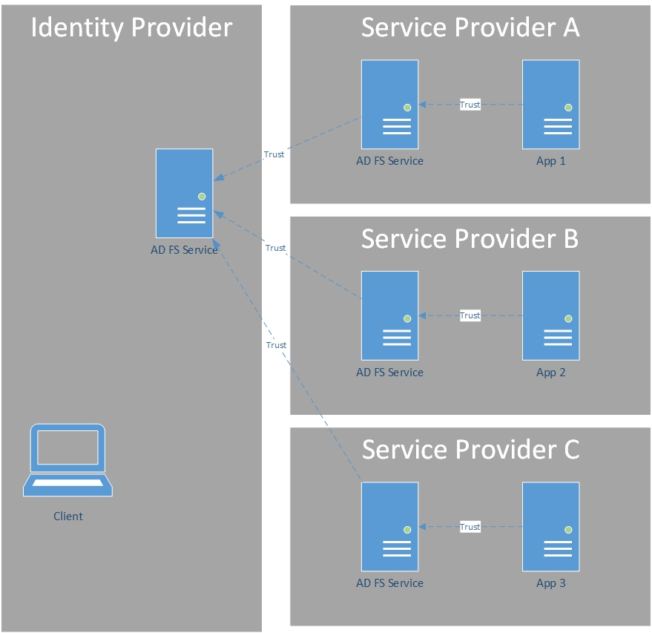
Security Token Service
Trust
Trust
AD FS Service
AD FS Service
App 1
Authentication is provided by means of tokens that
Identify the user
Are cryptographically signed with digital certificates (establishing trust)
Are transported using SSL encrypted HTTP (HTTPS)
Security Token Service (STS)
This is the main role of AD FS !
AD FS is a Security Token Service (STS) for an AD domain/Forest
This service builds & issues SAML Security Tokens (once the user is authenticated).
This service can also « swap » tokens as a request crosses security realm boundaries.
AD FS may act as Identity & Service provider
Claims producer
Claims Provider / Identity Provider : AD FS that authenticate users
Claims consumer/producer :
Relying Party / Service Provider : AD FS that provides Security Token to application
Trust
Trust
Trust
AD FS Service
App 2
client
Trust
App 3
AD FS Service
Notes:
AD FS is fundamentally a Security Token Service (STS).
A Security Token Service (STS) can issue tokens in various formats and can protect the content of security tokens in transit via the use of X.509 certificate(s) for token signing, which makes it possible for a relying party to notably validate trusted claims providers. (Token encryption is also supported.) The concept of exchange induces the processing and transforming capability of tokens in terms of type of trust, token format, semantics and (values of) claims for “impedance adaptation”.
In order to serve and process related claim requests, AD FS includes a claims pipeline, which represents the path that claims must follow through the STS before they can be issued as part of a security token. The STS manages the entire end-to-end process of flowing claims through the various stages of the claims pipeline, which also includes the processing of claim rules by the claim rule-based engine.
For that purpose, AD FS uses AD DS as a credential store. AD FS can also use attributes coming from several attribute stores, such as Active Directory Lightweight Directory Services (AD LDS), Microsoft SQL Server databases, and other data sources.

Slide 14


AD FS Provides a Security Token Service
2. Authenticates user
Identity Provider (IP)
Security Token Service (STS)
Claims Provider
User / Subject /Principal
1.Requests token for User
Active Directory
ST
2. Issues Security Token
crafted for Appx
The Security Token
Contains claims about the user
For example:
Name
Group membership
User Principal Name (UPN)
Email address of user
Email address of manager
Phone number
Other attribute values
3. Security Token “Authenticates” user to the application
AppX
Relying Party (RP)
4. Trusts the Security Token
from the issuer
Signed by issuer
Notes:
The user authenticates to the IP-STS by providing appropriate credentials, such as a username and password.
After validating the user’s credentials (contact Domain Controller), the IP-STS issues a signed token (ST) containing claims relevant to the Web application.
The user presents the new token to the Web Application. The Web Application will accept the token because it is issued by the STS. It will use the claims contained within the token to perform authorization against the requested resource.
The Web Application returns a session cookie to the user
AD FS is based on industry standards. there is new terminology associated.
Many of these new important terms are listed below.
Federation Service: A logical instance of AD FS. A federation service can be deployed as a single federation server or as a load-balanced federation server farm.
Security Token Service (STS): A web service that authenticates clients. The STS issues security tokens to authenticated clients.
Claims Provider: A federation service that issues claims for a particular transaction (also referred to as an IdP or Identity Provider).
Relying Party: A federation service or application that consumes claims (also referred to as an SP or Service Provider).
Security Assertion Markup Language (SAML): An OASIS specification that defines how to use HTTP web browser redirects to exchange assertions data. SAML is used to authenticate and authorize users across secure boundaries.
SAML Token: The data format for communicating claims between a claims provider and a relying party. AD FS 2.0 uses both SAML 1.1 and SAML 2.0 formats.
WS-Trust: The SOAP protocol, which is defined by the WS-Trust specifications, for requesting claims from a claims provider. AD FS 2.0 uses both the February 2005 and 1.3 versions of the protocol.

Slide 15
AD FS : roles
AD FS Farm Roles – Federation Server
Holds configuration for trust relationships with applications and/or other Security Token Services (STS)
Issues authentication tokens for access to trusting applications and/or Security Token Services
Audits authentication attempts
Interfaces with other services (e.g. Device Registration Service)
Is AD Domain Joined
AD FS Configuration Database
Stores AD FS Farm Configuration (trusts, certificates, logon page formatting etc.)
Stores the configuration for the Web Application Proxy (published web sites)
May utilize Windows Internal Database (WID) or SQL Server
AD FS Farm Roles – Web Application Proxy (WAP)
Provide reverse proxy functionality for web applications
Proxy authentication requests to AD FS farm servers (ADFS proxy)
Usually reside in a workgroup (not domain-joined)
Tag authentication requests as coming from outside the LAN
Can be domain-joined for usage of Constrained delegation
Notes:
Federation Server are each server with the ADFS Role installed.
Generally, AD FS is known as a Security Token Service (STS). AD FS issues tokens to clients to be used in the authentication process. Not just any application can benefit from this type of authentication. Applications are typically referred to as claims-aware if they are capable of consuming a token for authentication. This term is used because the token contains claims that describe the user. These claims can then be used by the claims-aware application to determine access to resources or to customize elements of the application itself.
To establish trust, the token is digitally signed with an X.509 certificate. This certificate is configured as trusted by the application. As long as the token signature is valid and the certificate used to sign it is valid, the user is considered authenticated.
If the certificate expires or becomes invalid, then AD FS must be configured with another token-signing certificate. This also means the applications must be updated to reflect this new certificate.
AD FS Configuration Database
https://technet.microsoft.com/en-us/library/ee913581.aspx
Each Federation Server needs a Configuration Database store with the service configuration. It is possible to use Windows Internal Database (WID), which is local to each server and only the primary server can write on the database, or use an SQL instance to maintain the database. SQL is required for token replay detection and SAML artefact resolution
Web Application Proxy
Most organizations attempt to provide robust mechanisms to secure Active Directory Domain Controllers because of their sensitive nature. AD FS is no different. Because it issues security tokens, it should be treated as a security sensitive service as well. To decrease the exposure to the external network or a perimeter network (also known as DMZ, demilitarized zone, and screened subnet), the Web Application Proxy can be used.
Security is achieved by making Web Application Proxy a transporter of authentication requests and responses, without the need to contact the authentication store (Active Directory). To increase the separation, it is recommended that the federation server proxy is not joined to Active Directory. Instead, the proxy maintains its trust relationship to the federation service using a proxy trust token. This trust token is obtained by running the Configuration Wizard or PowerShell cmdlet and specifying an account to use that is a member of the local administrators group on the federation servers.
Web Application Proxy are flexible in both deployment and maintenance. A single proxy can service one or many federation servers. The opposite is also true. Multiple proxies can service one federation server if desired. This flexibility allows for scalability and redundancy to be expanded in a short time frame.
Maintaining the Web Application Proxy trust relationship is automated. After initially configuring the user name and password to be used, the proxy server renews the proxy trust token every four hours. Because it is valid for 15 days by default, multiple attempts will occur before the trust relationship is broken. Settings concerning the proxy trust can be managed with Windows PowerShell or the wizard.
For more information: Federation Server Farm Using SQL Server and Proxies http://technet.microsoft.com/en-us/library/gg982487(v=ws.10).aspx

Slide 16
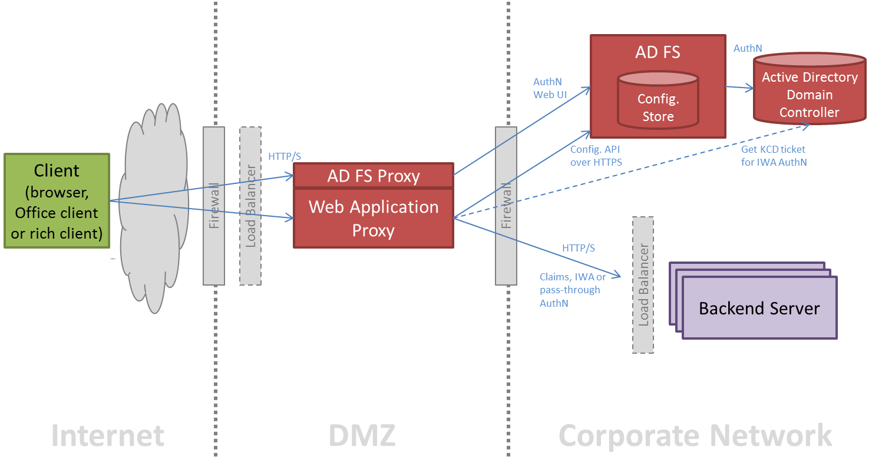
AD FS Architecture: Web Application Proxy traffic flow overview

Slide 17
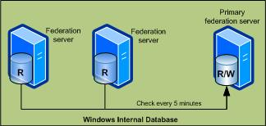
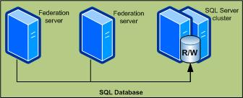
AD FS Farm Topologies
 | ADFS Farm with WID | ADFS Farm with SQL
Pros | Easy to implement (Recommended deployment topology) Load balancing and fault tolerance possible Easily scalable | No limit to the number of AD FS servers Load balancing and fault tolerance possible Easily scalable Supports SAML artefact resolution and token replay detection Configuration changes on any AD FS server
Cons | Supports limit of 30 AD FS servers Support limit of 100 trust entries No support for SAML artefact resolution No support for token replay detection Configuration changes only on primary federation server | More complex setup Dependent on SQL Server Makes high availability (HA) more difficult

Slide 18
AD FS Configuration Database requirements
Configuration Database (WID)
Is present on each AD FS server: no need for fault tolerance at the database level
Replicates using an HTTP endpoint (not SQL Server replication)
If primary AD FS server is down:
Users can still authenticate to other AD FS servers
Changes cannot be made by administrators
Primary Server Role can be moved to another server (PowerShell)
Limited to 30 Federation Servers
Limited to 100 Relying Parties
No SAML Artifact Resolution (Not used by Office 365)
Recommended for most environments
Configuration Database (SQL)
SQL Server does not run on AD FS servers
If SQL Server is unreachable by AD FS, users cannot authenticate
Fault tolerance must be implemented in SQL Server
Introduces a lot of complexity!
AD FS in Windows Server 2012 R2 and up consider using SQL Server AlwaysOn
No scalability limits
Supports SAML Artifact Resolution
It is possible to migrate from the WID database to the SQL Server database
Notes:
For more information on the role of the AD FS configuration database, refer to: http://technet.microsoft.com/en-us/library/ee913581.aspx
Windows Internal Database (WID):
Database location: C:\Windows\WID
WID replication:
Default port 80
Default 5-minute interval
It is possible to migrate from WID to SQL Server database
To move the primary role:
Run the following commands on new primary:
AD FS 2.0: Set-ADFSSyncConfiguration -role PrimaryComputer
AD FS on Windows Server 2012 R2: Set-ADFSSyncproperties -role PrimaryComputer
Run on all secondary:
AD FS 2.0: Set-ADFSSyncConfiguration -role SecondaryComputer -PrimaryComputerName <FQDN of new primary>
AD FS on Windows Server 2012 R2: Set-ADFSSyncproperties -role SecondaryComputer -PrimaryComputerName <FQDN of new primary>
SQL Server Database:
SQL Server adds additional complexity if high availability is required. Because SQL Server must always be available in order for AD FS to authenticate users, SQL Server should be configured in a highly available manner.
For previous (Windows Server 2012 and older) versions of AD FS, you should:
Have two SQL Server clusters in different datacenters.
Have synchronous mirroring between clusters.
Consider witness server for automatic failover.
Comparison:

Slide 19
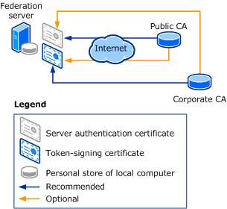
AD FS Certificate requirements
AD FS uses certificates for :
issuing and receiving tokens (token-signing / token-encryption),
publishing federation metadata (signing / encryption),
communicating through SSL (https)
Service communication Secure Sockets Layer (SSL) certificate:
Is used to establish SSL connections
Should be a third-party certificate
The subject name should match the AD FS service name
Token signing certificate:
Is used to sign SAML tokens sent to the applications
Is created as a self-signed certificate by default
It can be difficult to change/update, as all relying party trusts must be updated to trust a new certificate
Token encrypting/decrypting certificate:
Is used to encrypt SAML tokens sent from claims providers to AD FS
Is created as a self-signed certificate by default
Can be difficult to change/update, as all claim provider trusts using token encryption must be updated to use new certificate
Notes:
Service Communication SSL Certificate
The AD FS service communication certificate is the SSL certificate. AD FS is ultimately a web service, and the SSL certificate is used to secure communications with clients.
Other than the name, this certificate is no different than any other SSL certificate obtained for a website. In almost all circumstances, it should come from a third-party Certification Authority (CA).
The subject name should match the AD FS service name, not any individual server. Wildcard certificates are supported, as are certificates that use subject alternative names.
Relatively easy to change/update.
No reason to contact trust partners.
For security reasons we recommend that you use the same SSL certificate on all AD FS servers and another SSL certificate with the same subject name on all AD FS proxy (Web Application Proxy) servers
SSL Certificate:
Wildcard certificates are supported.
Subject Alternative Names are supported.
Token Signing Certificate:
The AD FS, a token-signing certificate is used to sign the Security Assertion Markup Language (SAML) tokens that authenticate clients. By default, AD FS will create a self-signed certificate and store it in AD DS. This can be replaced with a certificate obtained from an internal or a third-party CA if desired.
No extended key usage (EKU) or subject name requirements exist.
Each relying party (service provider) partner must trust this certificate. When this certificate needs to be changed, the replying parties need to be updated. Failure to do this will result in the failure of authentication to the relying parties.
Can implement certificate from internal Public Key Infrastructure (PKI ) or third-party CA.
Has no subject name requirements.
Self-signed certificates can utilize Auto Certificate Rollover.
Token Encrypting/Decrypting Certificate:
Can implement certificate from internal Public Key Infrastructure (PKI ) or third-party CA.
Has no subject name requirements.
Self-signed certificates can utilize Auto Certificate Rollover.
The AD FS token encrypting/decrypting certificate is used to encrypt the SAML tokens used for authentication. This is optional and encryption is not done by default.
This certificate is only used if AD FS is a claims provider (service provider) to a partner. In this case, the certificate’s public key is stored by the partner and is used to encrypt tokens sent to AD FS.
If the self-signed certificate for token-signing and/or token encrypting/decrypting is used, then the Automatic Certificate Rollover feature can be used. If either of these certificates is replaced with one generated by a CA (internal or public) then automatic certificate rollover must be disabled.
To facilitate the use of this feature, the self-signed certificates are not stored in the certificate container of the AD FS servers. Instead they are stored in the domain partition in which the AD FS servers are joined: CN=ADFS,CN=Microsoft,CN=Program Data,<domain name>
It is important to understand the settings related to automatic certificate rollover and be sure to note the dates on a calendar to ensure appropriate actions are taken to update relying parties and claims providers when these certificates are updated. The relevant settings are on the next slide.

Slide 20
AD FS & DNS Requirement (split-brain DNS)
Federation service name:
A fully qualified domain name (FQDN) for the AD FS deployment (The same federation service name is used internally and externally, which will require split-brain domain name system (DNS) )
Specified during the initial AD FS configuration : Example: sts.contoso.com
Split-brain DNS is required when users reside inside and outside the network
Internal users must resolve to internal VIP for AD FS servers
External users resolve to external VIP for WAP servers
WAP servers must resolve to internal VIP for ADFS servers
Use an A (host) record for the federation service name:
Do not use a CNAME (alias), if you do Kerberos won’t work
Notes:
When deploying AD FS, it is important to consider Domain Name System (DNS). Typically AD FS is deployed in both the intranet and perimeter network). To allow users to access AD FS externally, DNS is configured in a split-brain manner. This allows external clients to be directed to the Virtual IP (VIP) for the proxy servers while internal clients are directed to the VIP of the internal AD FS servers.
For intranet access, all clients accessing AD FS service within the internal corporate network (intranet) must be able to resolve the AD FS service name (name provided by the SSL certificate) to the load balancer for the AD FS servers or the AD FS server.
For extranet access, all clients accessing AD FS service from outside the corporate network (extranet/internet) must be able to resolve the AD FS service name (name provided by the SSL certificate) to the load balancer for the Web Application Proxy servers or the Web Application Proxy server.
For extranet access to function properly, each Web Application Proxy server in the DMZ must be able to resolve AD FS service name (name provided by the SSL certificate) to the load balancer for the AD FS servers or the AD FS server. This can be achieved using an alternate DNS server in the DMZ network or by changing local server resolution using HOSTS file.
For Windows Integrated authentication to work inside the network and outside the network for a subset of endpoints exposed through the Web Application Proxy, you must use an A record (not CNAME) to point to the load balancers.

Slide 21
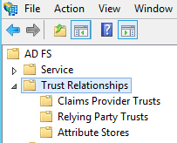
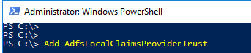
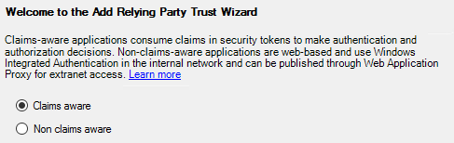
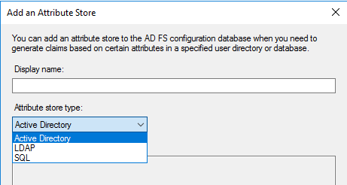
AD FS: Trust relationships
A federation Trust Relationships involves the exchange of identifying certificates that make it possible for the relying party to trust the contents of claims (Tokens) that the claims provider issues…
Claim provider trust
Local AD (exist by default)
New in 2016: LDAP Authentication Store
Other Identity providers
Relying party trusts
2 types :
Claims aware
(on premises Web Apps or cloud web apps, such Office 365)
Non-claims aware:
AD FS 2012 R2 and up
Application is accessed through WAP
WAP is required to be domain joined (for IWA/KCD)
Relying party trusts
Attribute store
AD FS may retrieve attribute values from various stores for populating claims value: AD/LDAP/SQL/Custom
Notes:
Claim provider trust:
A federation server operating as a claims provider provides the following functionality and services:
The claims provider presents a web service that can issue security tokens containing claims in a standardized format (for example, SAML).
The claims provider allows administrators to publish policy data about itself, which a relying party federation server can retrieve and use, to establish and maintain a federation relationship.
Relying party
A relying party is a federation server that receives security tokens from a trusted identity provider. The relying party, or federation provider as it is also known, will then issue new security tokens that a local application can consume to make authorization and personalization decisions. By using a relying party in federation with an identity provider, organizations can offer web single sign-on to users from partner organizations, or across security boundaries in a single organization.
Non-claims aware relying party trusts are objects that are created to represent the trust between the federation service and a single web-based application that is not claims-aware and that is accessed through the Web Application Proxy.
A non-claims-aware relying party trust is a relying party trust which consists of identifiers, names, and rules for authentication and authorization when the relying party trust is accessed through the Web Application Proxy. These web-based applications that do not rely on claims, in other words, these integrated windows authentication-based applications, can have authorization rules that enforce access that is based on claims when the access is external to the corporate network through the Web Application Proxy.
Important: For the non-claims-aware relying party trusts to function there has to be a Web Application Proxy that can orchestrate the authentication and authorization, and can translate to the authentication protocol of the application that it represents.
Attribute store:
AD FS uses the term attribute stores to refer to directories or databases that an organization uses to store its user accounts and their associated attribute values. After it is configured in an identity provider organization, AD FS retrieves these attribute values from the store and creates claims based on that information so that a Web application or service that is hosted in a relying party organization can make the appropriate authorization decisions whenever a federated user (a user whose account is stored in the identity provider organization) attempts to access the application or service.
AD FS supports a wide range of directory and database stores that you can use for extracting administrator-defined attribute values and populating claims with those values. AD FS supports any of the following directories or databases as attribute stores:
AD DS in Windows Server 2003, AD DS in Windows Server 2008, and AD DS in Windows Server 2012.
All editions of SQL Server 2005 and SQL Server 2008.
Custom attribute stores.

Slide 22

AD FS: Federation Trust illustration
Claims Provider (CP) Trusts
Another STS is providing a security token (claims) to this service
Contains information such as the signature verification certificate
Contains acceptance policy which determines how we process claims from this CP
Identity Provider
(Users)
E-Company Store
(Resource)
A. Datum
Account Forest
Resource Provider
(Application, such Office 365)
Microsoft
(Users)
Trey Research
Resource Forest
Federation Trust
* CP Trust
RP Trust
CP Trust
RP Trust
Relying Party (RP) Trusts
This service is sending a security token (claims) to another STS, service, or application
Contains information such as the encryption certificate
Contains authorization policy and issuance policy which determines how we process claims to send to this RP
CP Trust
Notes:
Claim provider trust:
A federation server operating as a claims provider provides the following functionality and services:
The claims provider presents a web service that can issue security tokens containing claims in a standardized format (for example, SAML).
The claims provider allows administrators to publish policy data about itself, which a relying party federation server can retrieve and use, to establish and maintain a federation relationship.
Relying party
A relying party is a federation server that receives security tokens from a trusted identity provider. The relying party, or federation provider as it is also known, will then issue new security tokens that a local application can consume to make authorization and personalization decisions. By using a relying party in federation with an identity provider, organizations can offer web single sign-on to users from partner organizations, or across security boundaries in a single organization.
Non-claims aware relying party trusts are objects that are created to represent the trust between the federation service and a single web-based application that is not claims-aware and that is accessed through the Web Application Proxy.
A non-claims-aware relying party trust is a relying party trust which consists of identifiers, names, and rules for authentication and authorization when the relying party trust is accessed through the Web Application Proxy. These web-based applications that do not rely on claims, in other words, these integrated windows authentication-based applications, can have authorization rules that enforce access that is based on claims when the access is external to the corporate network through the Web Application Proxy.
Important: For the non-claims-aware relying party trusts to function there has to be a Web Application Proxy that can orchestrate the authentication and authorization, and can translate to the authentication protocol of the application that it represents.

Slide 23
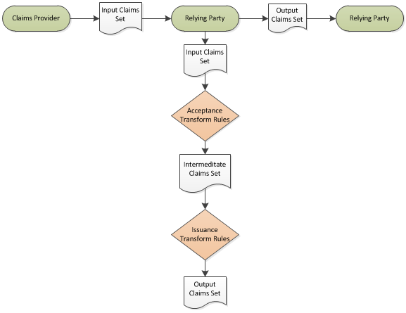
AD FS : Transform rules / Claim Rules (policy)
Recall: The main function of AD FS is to issue a token that contains a set of claims.
The decision regarding what claims AD FS accepts and issues is governed by claim rules.
Claim rules
Allow the administrator to granularly control which Claim Types from one STS to another STS (or Relying Party) are
issued or consumed
and how the claim values for each claim type are handled
Claim Rules are utilized in acceptance and issuance policy for CP and RP trusts
per
CP trust
per RP trust
AD FS
Notes:
The overall function of the Federation Service in Active Directory Federation Services (AD FS) 2.0 is to issue a token that contains a set of claims.
The decision regarding what claims AD FS accepts and then issues is governed by claim rules.
Claim Rules are utilized in acceptance and issuance policy for CP and RP trusts
AD FS provides built-in templates to help construct common rules
Examples: extract values from an attribute store as a claim type, transform a claim value or claim type, based on security group membership, send claim type X with value Y
Claim Rule Language (CRL)
language syntax specific to AD FS
allows authoring of custom rules that go beyond the provided templates

Slide 24
Claim Pipeline
Four stages to claim request processing:
Acceptance Transform Rules
Accepts incoming claims from Claim Providers
Additional Authentication Rules
Checks MFA policies
Halts the pipeline if the user is unauthenticated
Issuance Authorization Rules
Authorizes the user to receive claims for the Relying Party See http://technet.microsoft.com/en-us/library/dn280937.aspx
Halts the pipeline if the user is unauthorized
Issuance Transform Rules
Issues outgoing claims
Notes:
Acceptance transform rules:
This is stage one of the pipeline.
Applied when claims are received from a trusted claims provider.
Can be AD DS or another STS.
Only incoming claims that meet these rules will be accepted.
Apply broadly to all claims coming in from the claims provider.
Additional authentication rules:
This is stage two of the pipeline.
New addition to the pipeline in AD FS on Windows Server 2012 R2.
Used for processing authentication requirements.
Globally and per relying party
Issues the multiple authentication claim to trigger MFA.
Only view rules through Windows PowerShell.

Slide 25
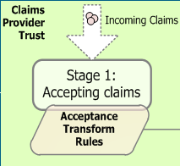
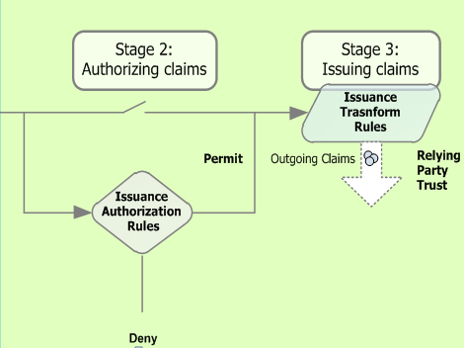
Acceptance / MFA / Issuance AuthZ / Issuance - Claims rules
Identity Provider
(Users)
E-Company Store
(Resource)
A. Datum
Account Forest
Resource Provider
(Application)
Microsoft
(Users)
Trey Research
Resource Forest
Global MFA : Additional Authentication Rules
Federation Trust
* CP Trust
RP Trust
CP Trust
RP Trust
MFA per RP: Additional Authentication Rules
MFA per RP: Additional Authentication Rules
CP Trust
Deny
Deny
Notes:
Four stages to claim request processing:
Acceptance Transform Rules
Accepts incoming claims from Claim Providers
Additional Authentication Rules (New in 2012 R2)
Checks MFA policies
Halts the pipeline if the user is unauthenticated
Issuance Authorization Rules
Authorizes the user to receive claims for the Relying Party See http://technet.microsoft.com/en-us/library/dn280937.aspx
Halts the pipeline if the user is unauthorized
Issuance Transform Rules
Issues outgoing claims

Slide 26
AD FS : Federated authentication flow principle (passive scenario)
Identity Provider
(Users)
E-Company Store
(Resource)
User browses to application
Anonymous landing page or automatic redirect?
Application redirects to its own federation service
Home Realm Discovery
Redirects to IdP Federation Service
Sign-in against AD (e.g Kerberos ticket)
IdP issues a SAML Token, according :
Claims provider trust rules
Relying party trust rules
Redirects back to the resource Federation services
RP-STS consumes and issues a new SAML Token, according :
Claims provider trust rules
Relying party rules
Redirects backs to application
A. Datum
Account Forest
Resource Provider
(Application)
Microsoft
(Users)
Trey Research
Resource Forest
Federation Trust
HTTP POST
HTTP POST
HTTP POST
HTTP Redirect
HTTP GET
HTTP POST
HTTP GET
HTTPS traffic

Slide 27
AD FS: Authentication Flow (Passive Scenario)
Browser
Identity Provider (IdP-STS)
Service Provider (SP)
Application (RP)
1. Request Resource
2. Redirect to ServiceProvider
3. Auth/N
4. Home-realm
Discovery
5. Redirect to IdP
6. Login
7. Authenticate &
Issue Token
8. Redirect to SP
9. Send Token to SP
10. Validate Token, Run Rules Engine, Issue Token
11. POST to RP with SP token
12. Send SP Token to Relying Party
14. Return resource representation
13. Validate
Token

Slide 28
AD FS: Authentication Flow (Active Profile)
Client
Identity Provider
Service Provider
Service
1. Send Credentials/Token
2. Authenticate & Issue Token
3. Return IdP Token
4. Send IdP Token
5. Validate Token, Run Rules Engine, Issue Token
6. Return SP Token
12. Validate
Token
& Execute
Operation
7. Send SP to Application

Slide 29
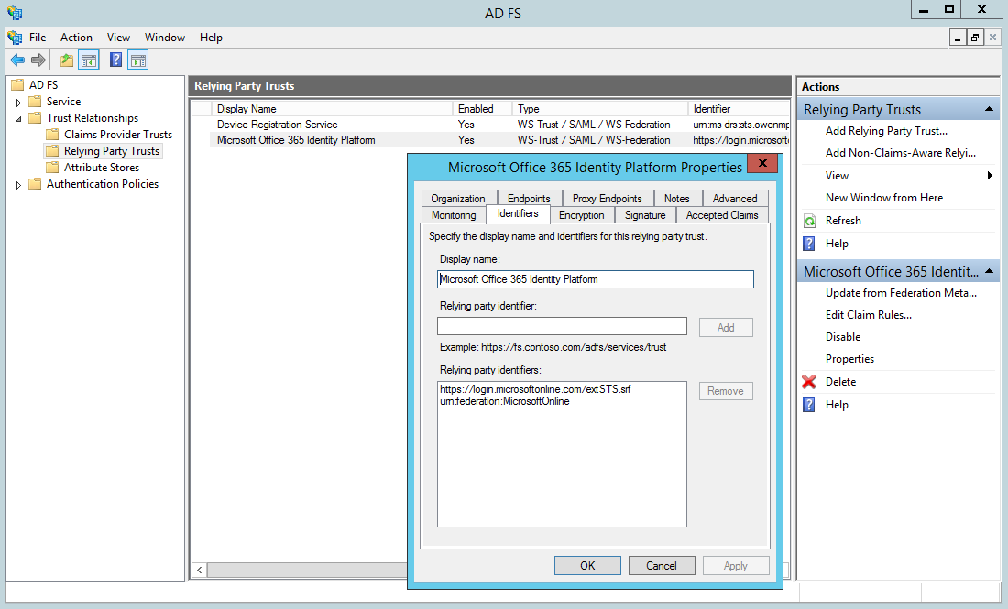
AD FS : Azure AD (Office 365) Relying Party Trust
The federation trust between AD FS and Azure AD (Office 365) can be created
Either through powershell
Or through Azure AD connect itself when ADFS is managed from Azure AD Connect
Azure AD (Office 365) is seen as a Relying Party trust

Slide 30


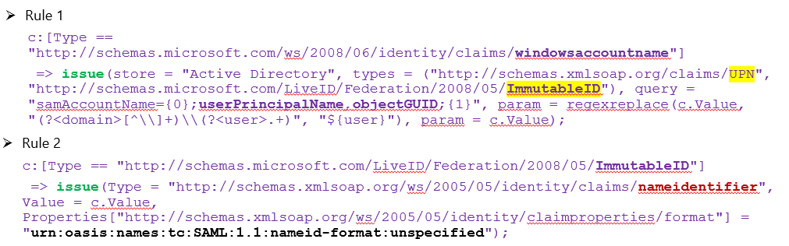
On Azure AD side :
PS C:\> Get-MsolDomainFederationSettings -DomainName albertma.msftonlinerepro.com
ActiveLogOnUri : https://sts.albertma.msftonlinerepro.com/adfs/services/trust/2005/usernamemixed
DefaultInteractiveAuthenticationMethod :
FederationBrandName : sts.albertma.msftonlinerepro.com
IssuerUri : http://albertma.msftonlinerepro.com/adfs/services/trust/
LogOffUri : https://sts.albertma.msftonlinerepro.com/adfs/ls/
MetadataExchangeUri : https://sts.albertma.msftonlinerepro.com/adfs/services/trust/mex
NextSigningCertificate :
OpenIdConnectDiscoveryEndpoint :
PassiveLogOnUri : https://sts.albertma.msftonlinerepro.com/adfs/ls/
SigningCertificate :MIIC/DCCAeSgAwIBAgIQIP91bCrWS7BNd2CBFdy0hzANBg
SupportsMfa : False
PromptLoginBehavior : TranslateToFreshPasswordAuth
AD FS / AAD relashionship
Identity Provider
(Users)
A. Datum
Account Forest
Microsoft
(Users)
Federation Trust
On-premises AD
* CP Trust
RP Trust
AD FS
Active Directory
(Minimum) Issuance transform rules
29

Slide 31
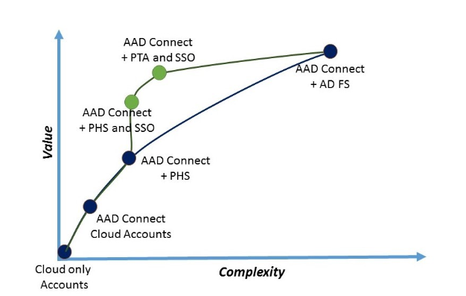
Recall: Azure AD Authentication choices (Sign-in options)
Cloud only accounts:
User accounts are maintained and authenticated in Azure AD.
AAD Connect / Cloud Accounts:
You can use Azure AD Connect to sync user accounts into Azure AD so the login id (usually the user’s email address) is the same, but the users must maintain their own passwords in the cloud service.
AAD Connect + PHS (user sign-in based on PHS):
When you turn on the password hash synchronization optional feature in Azure AD Connect, the user password hashes stored in your on-premises Active Directory will be synchronized into Azure AD, thus enabling same sign-on.
If combined with Seamless SSO feature
Domain joined PC on the corporate network can use Kerberos authentication against Azure AD (using effective SSO)
AAD Connect + PTA (user sign-in based on PTA):
PTA is designed for the use case where the client doesn’t have a Kerberos ticket, either because the Kerberos client can’t reach a DC (for example when an employee is working from home on their corporate notebook) or because the client doesn’t support Kerberos (for example a mobile browser or app that doesn’t support modern authentication).
No password hashes stored in Azure AD / All authN happens against on-prem AD
Can be also combined with Seamless SSO
When users are accessing applications on their corporate machines inside their corporate network, they don't need to type in their passwords to sign in.
AAD Connect + AD FS:
The most complete and most complex solution by a good margin, this combination will provide SSO (single sign-on) to Azure AD, authenticating against the accounts in your local Active Directory.
Azure AD Authentication choices
Notes:
Azure Active Directory (Azure AD) Connect allows your users to sign in to both cloud and on-premises resources by using the same passwords.
This section describes key concepts for each identity model to help you choose the identity that you want to use for signing in to Azure AD.
If you’re already familiar with the Azure AD identity model and want to learn more about a specific method, see the appropriate link:
Password hash synchronization with Seamless Single Sign-on (SSO)
Pass-through authentication with Seamless Single Sign-on (SSO)
Federated SSO (with Active Directory Federation Services (AD FS))
Federation with PingFederate

Slide 32

Recall: : The Azure AD Identity Models
New Identity Models
There are 5 design options to consider for enabling users to authenticate to cloud services.
Managed Identities
Federated Identities
Managed Identities
Pure Cloud Identity
Synchronized Identity (Password Hash Sync)
Federated Identity
Pass-Through Authentication
AAD Seamless SSO (is combined with PHS or PTA)
Azure Active Directory
Azure Active Directory
Azure Active Directory
Azure Active Directory
Azure Active Directory
Azure AD App Proxy Connector
Directory Sync and Password Sync
Directory Sync
Federation
Directory Sync
Directory Sync
Kerberos AuthN
Active Directory
Active Directory
Active Directory
Active Directory
Independent cloud identity
Single identity, enabling a sign-on like experience with password hash sync
Single identity, enabling single sign-on and additional flexibility
Single identity, enabling single sign-on in some scenarios and additional flexibility
True Single Sign-On (SSO) without ADFS.
Password stored in the cloud
Hash of Password hash stored in the cloud
Password stored on-premises
Password stored on-premises
Is combined with PHS or PTA
Notes:
As part of setting up a Common Identity, there are 5 design options to consider for enabling users to authenticate to cloud services:
Cloud Identity: the user identities and associated passwords reside in the cloud and no synchronization takes place with the on-premises Active Directory. In this case, authentication always occurs in the cloud and the users must use a separate password from the one used on-premises. This is the simplest scenario as there is no need to synchronize user identities from the on-premises Active Directory domains to the cloud.
Synchronized Identity: the user identities and associated passwords are synchronized from the on-premises Active Directory to the Microsoft Azure Active Directory. In this case, the same password can be used to authenticate the user either in the cloud or on-premises depending on what resource is being accessed. This scenario requires the use of the Azure Active Directory Synchronization Service (AAD Sync) with password hash synchronization enabled.
Federated Identity: all authentication is retained on-premises and all passwords are stored on-premises only. All authentication traffic is redirected from Azure Active Directory to the on-premises Active Directory Federation Service (AD FS), which authenticates the user against a trusted Active Directory domain. This scenario requires the use of a federation service provider such as Active Directory Federation Service (AD FS) in addition to AAD Sync.
Pass-through Authentication
What is Azure Active Directory pass-through authentication?
Allowing your users to use the same credentials (passwords) to sign in to both on-premises resources and cloud-based services benefits them and your organization. Users have one less password to remember, which provides a better user experience. It also reduces the chances that users will forget how to sign in. Your help-desk costs then decrease, because password-related issues typically consume the most support resources.
Azure AD Seamless SSO
Azure Active Directory Seamless Single Sign On (Azure AD Seamless SSO) provides true single sign on for users signing in on their corporate desktops connected on the corporate network. When enabled, users won't need to type in their passwords to sign in to Azure AD, and in most cases, even type in their usernames. This feature provides your users easy access to your cloud-based services without needing any additional on-premises components.+
Seamless SSO can be enabled via Azure AD Connect and can be combined with either password synchronization or pass-through authentication.

Slide 33
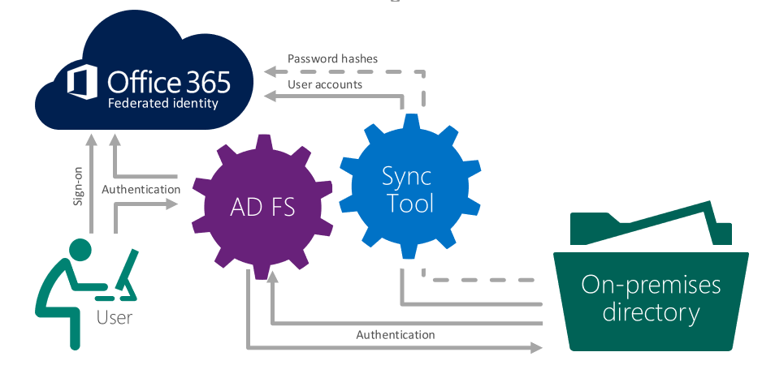
Federated Identity Model: Requirements
Synchronize local identities with Azure AD (Office 365 Tenant)
Deploy AD FS Farm
Create federation trust with Azure AD (Office 365 Tenant):
PowerShell
Connect-MsolService: Credential $cred
Set-MsolAdfscontext: Computer <AD FS server FQDN>
Convert-MsolDomainToFederated: DomainName <DomainToFederate>
Through Azure AD Connect
Creates additional claim rules! E.g. password expiry notifications, sends user location claim (recall; Azure AD Connect can install & configure ADFS as well)
By default the trust is based on WS-Federation/WS-Trust protocols
Azure AD updates federation trust metadata automatically
Make sure federation metadata URL is available from the internet!
Notes:
AD FS rolls over its token signing certificate once every 12 months (it is actually slightly less than that to account for the roll over period). During this period a secondary token signing certificate is created and added to the configuration of AD FS. It is then added to the federation metadata.
A domain in Azure Active Directory periodically (once every 24 hours) queries the federation metadata over HTTPS based on the URL that was supplied when the federation trust was first setup. If it differs from what it has in its configuration, it will update this. This way Azure AD is up to date with AD FS. So, when AD FS rolls over, there is no loss of business continuity because Azure AD knows about the new token signing certificate and it will accept it as well.
This requires inbound 443.

Slide 34
Federated user attempts to access Azure AD resource (or SaaS application) , user is redirected back to the AD FS end point based on the provided user’s UPN (from the UPN suffix, Azure AD know that is a federated user … ).
Azure AD redirects the user to his AD FS Farm with WIA SSO or Forms based AuthN if connecting from outside of corporate network
AD FS validates the user credentials against on-premises AD
A security token is issued by AD FS to the Office 365 Identity Platform containing mainly two user’s claims (userPrincipalName and ImmutableID )
Azure AD will decrypt the token and match the user to a shadow identity (created by Azure AD Connect Sync) in Azure AD This shadow identity will contain the same values for those two claims/attributes as on-premises thus matching the user per the claim The token is consumed and the user is allowed access to the Office 365 services
Recall: Azure AD Identity Models (3/5) – Federated Identity
Optionnal Password hashes
Federated Identity
User accounts
Active Directory
Azure AD Connect
Sign-on
5
Azure Active Directory
Authentication
AD FS
1
2
Directory Sync
Federation
Active Directory
Single identity, enabling single sign-on and additional flexibility
User
4
Authentication
3
On-premises
AD directory
Password stored on-premises
Notes:
Federated Identity: all authentication is retained on-premises and all passwords are stored on-premises only. All authentication traffic is redirected from Azure Active Directory to the on-premises Active Directory Federation Service (AD FS), which authenticates the user against a trusted Active Directory domain. This scenario requires the use of a federation service provider such as Active Directory Federation Service (AD FS) in addition to AAD Sync.
How it works
User enters username
Azure AD redirects the user to his AD FS Farm with WIA SSO or Forms based AuthN if connecting from outside of corporate network
AD FS validates the user credentials against on-premises AD
AD FS builds the SAML Token and returns it to the user (requestor)
The User Presents the token to Azure AD that validates the SAML Token and conclude the Authentication process.

Slide 35

Office 365 & Federated Authentication Flows (Legacy) – Passive requestor
Azure AD
Web Application
The flow depends on client app
AD FS
1. GET resource
2. Redirect to AAD
3. GET resource token
4. AAD sign-in page to gather Organization ID (UPN)
5. Redirect to AD FS
6. GET token for AAD
Passive requestor (web sso)
7. AD FS sign-in page to gather creds
8. Return token for AAD
9. POST token (containing mainly two user’s claims (userPrincipalName and ImmutableID )) for AAD
10. Return resource token
11. POST resource token
12. Return result

Slide 36

O365 & Federated Authentication Flows (Legacy) – Active requestor
The flow depends on client app
AD FS
Azure AD
Lync Online
1. Call HRD service with user domain
2. Return MEX endpoint
3. Get WS-Trust endpoints (MEX)
4. Return endpoints
5. Request token for AAD
6. Authenticate user
7. Return token for AAD
8. Request resource token
9. Return resource token
10. Connect with resource token
11. Authentication successful

Slide 37

O365 & Federated Authentication Flows (Legacy) – Proxied authentication
The flow depends on client app
AD FS
Azure AD
Exchange Online
1. Connect to EXO
2. Prompt for Basic AuthN creds
3. Call HRD service
4. Return active endpoint for domain
5. Proxy Basic AuthN creds, request token for AAD
Outlook (old versions / non-modern authentication compatible )
6. Return token for AAD
7. Request resource token
8. Return resource token
9. Authentication successful

Slide 38
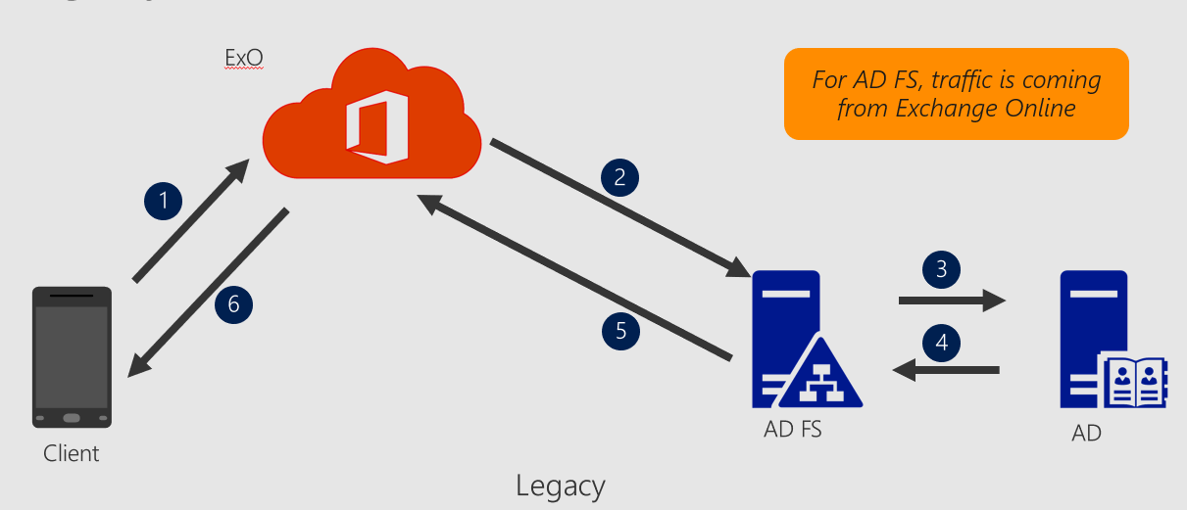
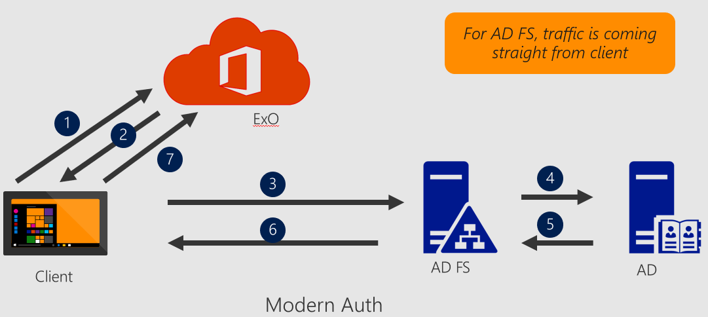
Basic vs Modern Authentication (outlook client example)
Basic Authentication: Outlook connects to Exchange Online using Basic authentication over HTTPS, which requires the credentials to be passed anytime a connection is made. Then Exchange Online proxying the credentials for authentication …
Modern Authentication (ADAL): Outlook communicates directly with the customer’s identity provider and no longer relies on Exchange Online proxying the credentials for authentication
ADAL uses OAuth standards and is supported on multiple platforms, including OS X, iOS, Android, and Windows.

Slide 39
Modern Authentication Flow - basics
Notes:
Office 2013 updated authentication enabling Multi-Factor Authentication and SAML identity providers https://blogs.office.com/2014/11/12/office-2013-updated-authentication-enabling-multi-factor-authentication-saml-identity-providers/
The ADAL-based authentication stack enables Office 2013 and Office 2016 clients to engage in browser-based authentication (also known as passive authentication) where the user is directed to a webpage from the identity provider to authenticate. The diagram on the slide shows the default webpage from Azure Active Directory (Azure AD), which is used by Office 365. This diagram shows how the updated Office 2013 Windows client applications enables user sign in. The Office 2013 and Office 2016 client applications use the ADAL component to facilitate sign-in with Azure AD. Azure AD hosts a web page where the user can sign in. The identity provider could be Azure AD or a federated identity provider such as Active Directory Federation Services (AD FS). If the user is a federated user, Azure AD redirects the user to the sign-in webpage hosted by the identity provider of record for the tenant. This identity provider is determined based on the domain as specified in the user’s sign-in name. The sign-in webpage is shown to the user on their device and the user signs in. The identity provider returns a token to Azure AD when the user is successfully signed in. Azure AD returns a JWT token to the Office client application and the client application can use this JWT token with Office 365 services on behalf of the user. There are several benefits to this approach, including that the Office client application never handles the user password, the identity provider can show multiple pages and custom user interfaces to the user, and customized sign-in can be enabled through integration with the identity provider.

Slide 40
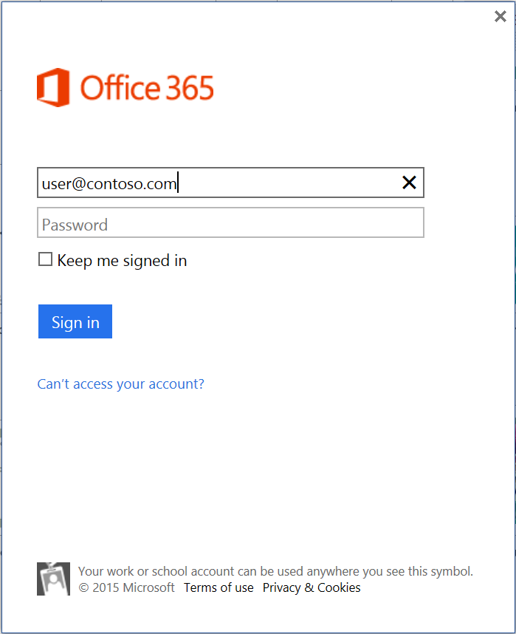


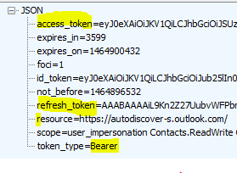
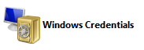
Modern Authentication (ADAL+OAUTH) : Outlook/Exchange online AuthN flow example
EXO
trust
Azure AD (EvoSTS)
federation
User
Outlook (Modern Auth) (2013/2016)
IDP (ADFS) “sts”
2. AutoDiscover, MAPI/HTTP, OAB (no token/no cred) “Authorization: Bearer” header ➔ ADAL request
1. Create a new profile or Open an existing profile
3. 401: need token from [authURL] “WWW-Authenticate: Bearer …” ➔ ADAL enabled
4. Implicit sign-in via WebView (Show Trident Control) Opt-in : MFA
For WIA this endpoint should be enabled : “/adfs/services/trust/13/windowstransport”
5. 200: GET [authURL/UserRealm/user@domain.com] (show login page)
6. OAuth Req : EvoSTS/oauth2/authorize?response_type= code…
7. 302 : STS endpoint returned – https://sts.domain.com
8. 200: GET [ADFS URL] / authN req
9. ADFS FBA prompt (or WIA)
10. Creds entered GET [ADFS URL] with creds
11. (verify Username /password)
12. 200 : [SAML token issued] included in javascript for POSTing it to EvoSTS
13. POST [SAML Token]
14. 302: (return OAUTH AuthZ code / redirect to EvoSTS : OAUTH/Token)
Conditional Access Policies evaluated here …
15. POST to OAuth/Token using the AuthZ code
(Legacy) ADFS Client Access Filtering …
16. 200: (return OAUTH Access/refresh token)
17. Request access to resource – with access token
18. 200: Response

Slide 41
AD FS : Friendly AD FS features for Azure AD
All enhanced sign-in experiences are available (except for home realm discovery which is not applicable for Azure AD/Office 365 scenarios)
Extranet password change
Extranet soft account lockout
Extranet Smart Lockout (new)
Reduction of SSO cookie size with Dynamic Group security identifier (SID) Hydration
Consistent client-request-id for troubleshooting
Password expiry notification

Slide 42
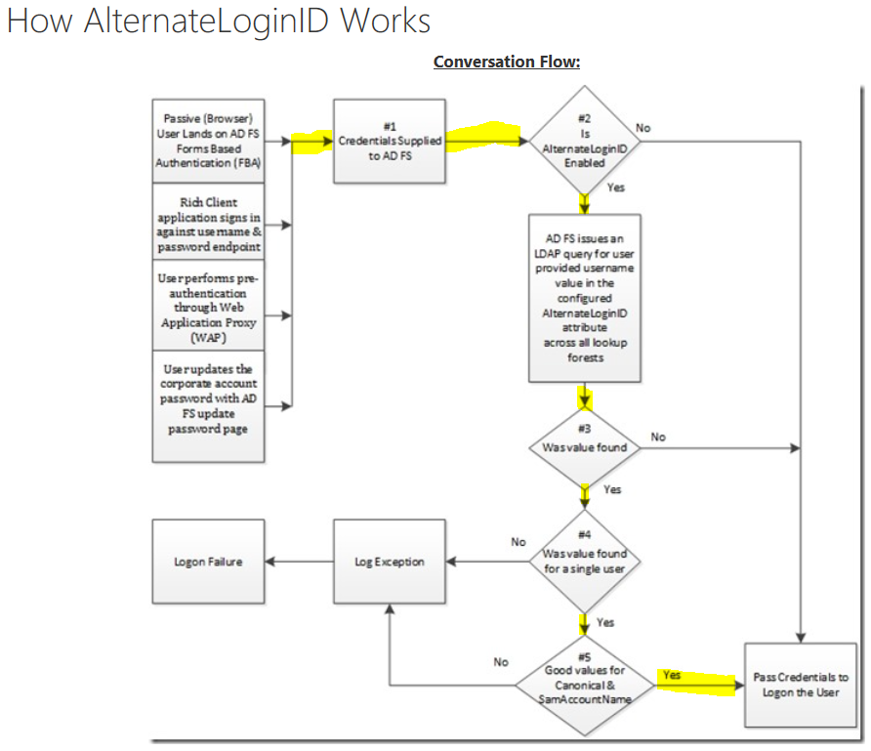
Alternate Login ID
By default, federation with Azure AD requires users to have a UPN that matches their publicly routable federated domain name (i.e. user@contoso.com)
If your on-premises UPNs are using non-routable domains (i.e. contoso.local) or your cannot change your existing UPN's to match your public domain due to application dependencies then you cannot use your on-premises UserPrincipalName attribute to authenticate your users to Azure AD
To solve this problem, you can enable the alternate login ID functionality which allows you to configure a sign-in experience where this alternate login ID is an attribute of a user object in AD other than the UPN that can be set to the public routable federated domain
Using the 'mail' attribute for alternate login ID functionality is strongly recommended
https://blogs.technet.microsoft.com/kaushika/2014/04/20/introduction-to-active-directory-federation-services-ad-fs-alternateloginid-feature/
Notes:
References :
Configuring Alternate Login ID : https://docs.microsoft.com/en-us/windows-server/identity/ad-fs/operations/configuring-alternate-login-id
Introduction to Active Directory Federation Services (AD FS) AlternateLoginID Feature : https://blogs.technet.microsoft.com/kaushika/2014/04/20/introduction-to-active-directory-federation-services-ad-fs-alternateloginid-feature/
Alternate login ID for Office 365 reduces dependence on UPN: http://blogs.office.com/2014/05/06/alternate-login-id-for-office-365-reduces-dependence-on-upn/

Slide 43
AD FS - Extranet Account Lockout security feature
This feature exists since ADFS 2012 R2 (aka. V3)
With this feature, AD FS will "stop" authenticating the "malicious" user account from outside for a period of time. Please note that this feature only applies to username and password authentication
First of all, it protects your user accounts from brute force attacks where an attacker tries to guess a user's password by continuously sending authentication requests.
In this case, AD FS will lock out the malicious user account for extranet access.
Second of all, it protects your user accounts from malicious account lockout where an attacker wants to lock out a user account by sending authentication requests with wrong passwords.
In this case, although the user account will be locked out by AD FS for extranet access, the actual user account in AD is not locked out and the user can still access corporate resources within the organization.
We call it soft-lockout as compared to actual AD account lockout.
This feature only works for extranet scenario where the authentication requests come through the Web Application Proxy.
This feature works independently from AD Lockout policy but you do need to consider a few things when it comes to configuring extranet lockout setting to make sure this feature work as intended.
See : Demystify extranet lockout feature in AD FS 3.0 :
https://blogs.msdn.microsoft.com/luzhao1/2015/06/24/demystify-extranet-lockout-feature-in-ad-fs-3-0/
Notes:
HOW DOES IT WORK
There are 3 settings in AD FS that you need to configure to enable this feature:
EnableExtranetLockout: set this Boolean value to be True if you want to enable Extranet Lockout.
ExtranetObservationWindow: this determines for how long the user account will be soft-locked out. AD FS will start to perform username and password authentication again when the window is passed. AD FS uses the AD attribute badPasswordTime as the reference for determining whether the extranet observation window has passed or not. The window has passed if current time > badPasswordTime + ExtranetObservationWindow.
ExtranetLockoutThreshold: this defines the maximum number of bad password attempts. Once the threshold is reached, AD FS will immediately rejects the requests from extranet without attempting to contact the domain controller for authentication, no matter whether password is good or bad, until the extranet observation window is passed. This means the value of badPwdCount attribute of an AD account will not increase while the account is soft-locked out.
An example of enabling Extranet Lockout feature with maximum of 15 number of bad password attempts and 30 mins soft-lockout duration is as follows:
Set-AdfsProperties -EnableExtranetLockout $true -ExtranetLockoutThreshold 15 -ExtranetObservationWindow (new-timespan -Minutes 30)
These settings apply to all domains that the AD FS service can authenticate. The way that it works is that when AD FS receives an authentication request, it will access Primary Domain Controller (PDC) through LDAP call and perform a lookup for the badPwdCount attribute for the user on the PDC. If AD FS finds the value of badPwdCount >= ExtranetLockoutThreshold setting and the time defined in the Extranet Observation Window has not passed yet, AD FS will reject the request immediately, which means no matter whether user enters good or bad password from extranet, the logon will fail because AD FS does not send credentials to AD. AD FS does not maintain any state with regard to badPwdCount or locked out user account. AD FS uses AD for all state tracking.
WORK TOGETHER WITH AD LOCKOUT POLICY
One of the areas that people get most confused about is how this feature works together with AD lockout policy. As I mentioned earlier, Extranet Lockout feature in AD FS works independently from AD lockout policy. However, you do need to make sure the settings for Extranet Lockout is properly configured such that it can serve its security purpose with AD lockout policy.
Let's take a look at AD lockout policy first. There are three settings regarding lockout policy in AD:
Account Lockout Threshold: this setting is similar to ExtranetLockoutThreshold setting in AD FS. It determines the number of failed logon attempts that will cause a user account to be locked out. In order to protect your user accounts from malicious account lockout attack, you want to set the value of ExtranetLockoutThreshold in AD FS < Account Lockout Threshold value in AD
Account Lockout Duration: this setting determines for how long a user account is locked out. This setting does not matter much in this conversation as Extranet Lockout should always happen before AD lockout happens if configured properly
Reset Account Lockout Counter After: this setting determines how much time must elapse from user's last logon failure before badPwdCount is reset to 0. In order for Extranet Lockout feature in AD FS to work well with AD lockout policy, you want to make sure the value of ExtranetObservationWindow in AD FS> Reset Account Lockout Counter After value in AD. We will use examples below to explain why.

Slide 44
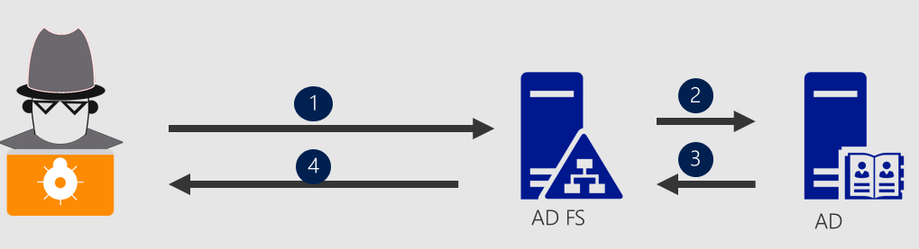
AD FS : Extranet SMART Lockout (ESL)
AD FS 2016 introduces a new feature called Extranet Smart Lockout (ESL) .
In an era of increased attacks on authentication services, ESL enables AD FS to differentiate between:
sign-in attempts that look like they're from the valid user (from familiar locations)
and sign-ins from what may be an attacker.
As a result, :
AD FS can lock out attackers while letting valid users continue to use their accounts.
This prevents denial-of-service on the user and protects against targeted attacks such as “password spray” attacks.
ESL is available for AD FS in Windows Server 2016 (March 2018 update for AD FS).
Problem to mitigate:
Attacker finds the federation endpoint
Direct brute force attack on “usernamepassword“ endpoint.
Any federation product faces similar threat
Notes:
Reference : Description of the Extranet Smart Lockout feature in Windows Server 2016 : https://support.microsoft.com/en-us/help/4096478/extranet-smart-lockout-feature-in-windows-server-2016
A new “Smart Account lockout” feature provided by AD FS 2016 for helping mitigate the problem where attackers could initiate :
Down-level authentication requests proxied by Exchange Online
Or Modern authentication request directly to the ADFS servers of federated Office 365 tenants.

Slide 45
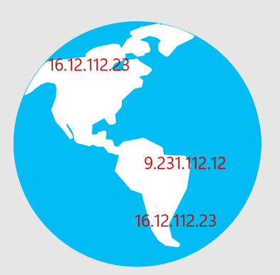
AD FS : Extranet Smart Lockout (ESL)
Scoping the problem
Remediate & Protect
Move from legacy auth to modern auth : Disable legacy authentication
Identify the IP pattern of the attacker
Block the traffic at Exchange Online
Block the traffic at AD FS (2016 or newer)
Tools
Azure AD Connect Health AD FS Bad IP Reporting
AD FS Events module @ AD FS Help (https://aka.ms/adfshelp) and parse event 411
Block the malicious IP ranges at ExO service
Set-OrganizationConfig -IPListBlocked <subnet or IP>
Extranet Lockout for AD FS Server 2012 R2
Extranet Smart Lockout for (AD FS 2016 and newer)
MFA as primary authentication (AD FS 2016 and new)
Notes:
Overview
As of the March 2018 update for AD FS in Windows Server 2016 delivered via Windows Update, AD FS has a new feature called Extranet Smart Lockout (ESL). In an era of increased attacks on authentication services, ESL enables AD FS to differentiate between sign-in attempts that look like they're from the valid user and sign-ins from what may be an attacker. As a result, AD FS can lock out attackers while letting valid users continue to use their accounts. This prevents denial-of-service on the user and protects against targeted attacks such as “password spray” attacks. ESL is available for AD FS in Windows Server 2016.
How to install and configure ESL
Install updates on all nodes in the farm
First, ensure all Windows Server 2016 AD FS servers are up to date as of the March 2018 Windows Updates.
Update artifact database permissions
Extranet smart lockout requires the AD FS service account to have permissions to a new table in the ADFS artifact database. Grant this permission by executing the following command in a PowerShell command window:
PS C:\>$cred = Get-Credential
PS C:\>Update-AdfsArtifactDatabasePermission -Credential $cred
Where $cred is an account with AD FS administrator permissions.
If you do not have AD FS administrator permissions, you can configure database permissions manually in SQL or WID by running the following command when connected to the AdfsArtifactStore database.
ALTER AUTHORIZATION ON SCHEMA::[ArtifactStore] TO [db_genevaservice]
Configure ESL
A new parameter called ExtranetLockoutMode was added support ESL. It contains 3 values
ADPasswordCounter – This is the legacy ADFS “extranet soft lockout” mode which does not differentiate based on location. This is the default value.
ADFSSmartLockoutLogOnly – This is Extranet Smart Lockout, but instead of rejecting authentication requests, ADFS will write admin and audit events.
ADFSSmartLockoutEnforce - This is Extranet Smart Lockout with full support for blocking unfamiliar requests when thresholds are reached.
We recommend that you first set the lockout provider to log only by running the following cmdlet:
PS C:\>Set-AdfsProperties -ExtranetLockoutMode AdfsSmartlockoutLogOnly
In this mode, AD FS performs the analysis but does not block any requests due to lockout counters. This mode is used to validate that smart lockout is running successfully before enabling “enforce” mode.
For the new mode to take effect, restart the AD FS service on all nodes in the farm
PS C:\>Restart-service adfssrv
Set lockout threshold and observation window
There are two key settings with ESL: lockout threshold and observation window.
Lockout Threshold
Each time a password based authentication is successful, ADFS stores the client IP(s) as familiar location(s) in the account activity table.
If a password based authentication fails and it is NOT from a familiar location, the failed authentication count is incremented.
Once the number of failed password attempts from unfamiliar locations reaches the lockout threshold, if a password based authentication from an unfamiliar location fails the account is locked out.
The threshold is set using Set-AdfsProperties
Example:
PS C:\>Set-AdfsProperties -ExtranetLockoutThreshold 10
Observation window
The observation window setting allows an account to automatically unlock after a certain period of time. Once the account unlocks it allows 1 authentication attempt. If the authentication succeeds the failed authentication count is reset to 0. If it fails then the system waits for another observation window before the user is allowed to try again.
The observation window is set using Set-AdfsProperties
Example:
PS C:\>Set-AdfsProperties -ExtranetObservationWindow ( new-timespan -minutes 5 )
Where the value is a TimeSpan
Enable lockout
Extranet lockout can be enabled / disabled using the EnableExtranetLockout parameter
Example: Enable lockout
PS C:\>Set-AdfsProperties -EnableExtranetLockout $true
Example: Disable lockout
PS C:\>Set-AdfsProperties -EnableExtranetLockout $false
Enable enforce mode
Once you are comfortable with the lockout threshold and observation window, ESL can be moved to “enforce” mode using the PSH cmdlet below:
PS C:\>Set-AdfsProperties -ExtranetLockoutMode AdfsSmartLockoutEnforce
For the new mode to take effect, restart the AD FS service on all nodes in the farm
PS C:\>Restart-service adfssrv
Managing ESL
Manage User Account Activity
ADFS provides 3 cmdlets to manage user account activity data. These cmdlets automatically connect to the node in the farm which holds the master role (though this behavior can be overridden by passing the -Server parameter)
Get-ADFSAccountActivity
Read the current account activity for a user account. The cmdlet always automatically connects to the farm master using the Account Activity REST endpoint, so all data should always be consistent
PS C:\>Get-ADFSAccountActivity user@upnsuffix.com
Set-ADFSAccountActivity
Update the account activity for a user account. This can be used to add new familiar locations or erase state for any account
PS C:\>Set-ADFSAccountActivity user@upnsuffix.com -AdditionalFamiliarLocation “1.2.3.4”
Reset-ADFSAccountLockout
Resets the lockout counter for a user account
PS C:\>Reset-ADFSAccountLockout user@upnsuffix.com -Familiar

Slide 46
AD FS : Extranet Smart Lockout (ESL)
There are two key settings with ESL: lockout threshold and observation window.
Lockout Threshold
Each time a password based authentication is successful, ADFS stores the client IP(s) as familiar location(s) in the account activity table.
If a password based authentication fails and it is NOT from a familiar location, the failed authentication count is incremented.
Once the number of failed password attempts from unfamiliar locations reaches the lockout threshold, if a password based authentication from an unfamiliar location fails the account is locked out.
The threshold is set using Set-AdfsProperties
Example:
PS C:\>Set-AdfsProperties -ExtranetLockoutThreshold 10
Observation window
The observation window setting allows an account to automatically unlock after a certain period of time. Once the account unlocks it allows 1 authentication attempt. If the authentication succeeds the failed authentication count is reset to 0. If it fails then the system waits for another observation window before the user is allowed to try again.
The observation window is set using Set-AdfsProperties
Example:
PS C:\>Set-AdfsProperties -ExtranetObservationWindow ( new-timespan -minutes 5 )
Where the value is a TimeSpan

Slide 47







Activity table … …
AD FS : Extranet Smart Lockout (ESL)
@$#%@$#@
if authN fails (lockout threshold) then the locations is seen as unfamiliar
Extranet Lockout Reached
AD FS
if authN success then the locations is seen as familiar
AD FS Proxy
Unknown IP (unfamiliar locations )
AD FS can lock out attackers while letting valid users continue to use their accounts.
This prevents denial-of-service on the user and protects against targeted attacks such as “password spray” attacks.
Known IP (familiar locations)
AD DS

Slide 48
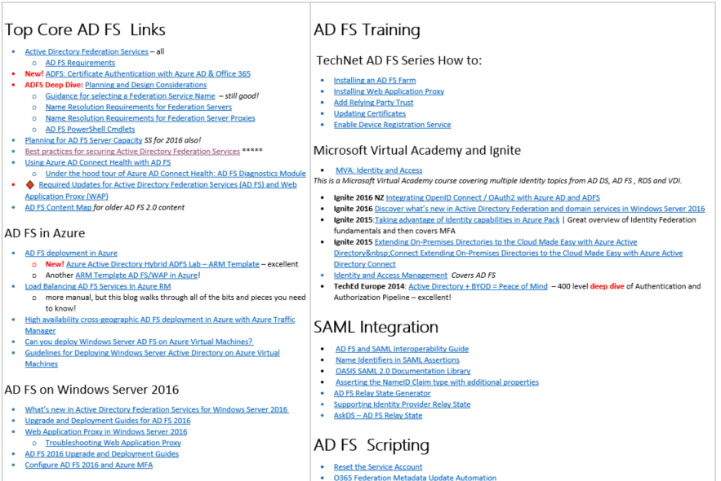
More information : aka.ms/ADFSLinks
QRG | Quick Reference Guide | Active Directory Federation Services | aka.ms/ADFSLinks

Slide 49
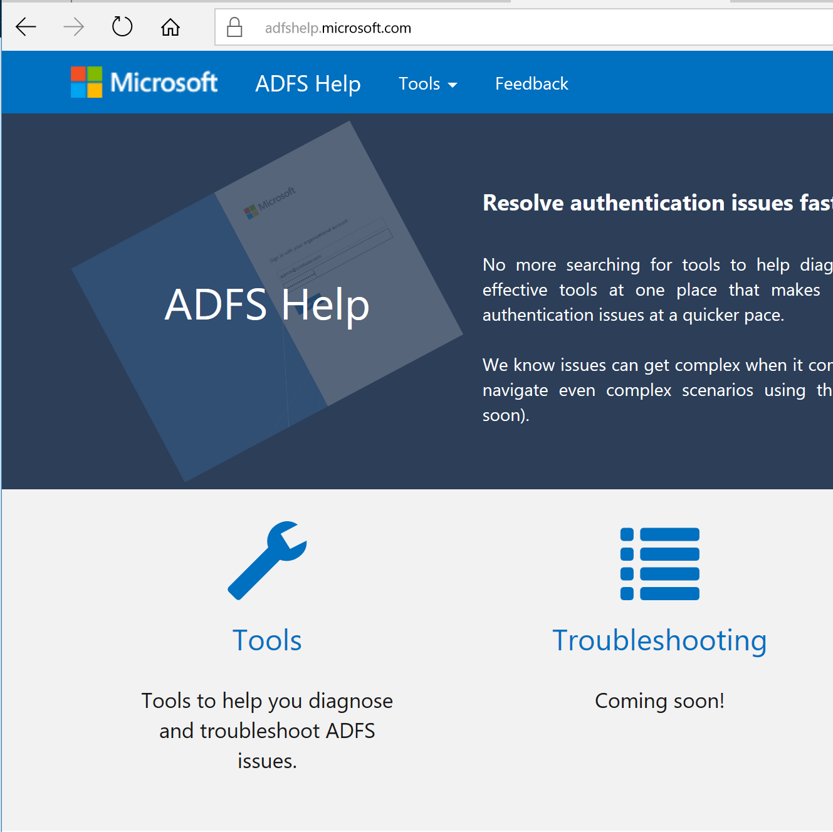
AD FS Help
https://aka.ms/adfshelp
One stop for resolving your federation issues
Tools to help you diagnose and troubleshoot AD FS issues

Slide 51
List of abbreviations
AD: Active Directory (on-premises) AAD: Azure Active Directory
Azure AD: Azure Active Directory
PTA : Pass-Through Authentication
PHS : Password Hash Synchronization

